Slide 1
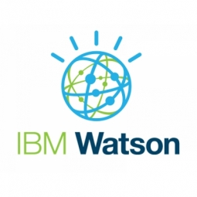
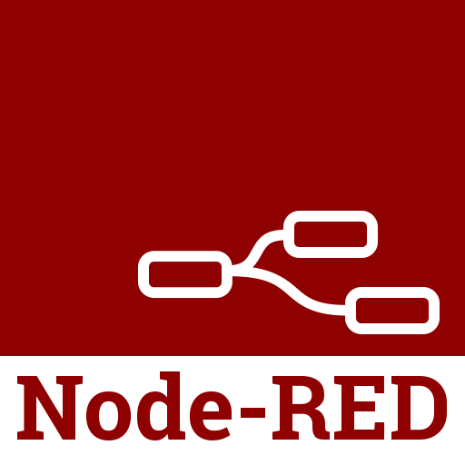
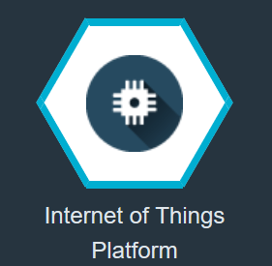
Block Diagram:
Web App
IBM WATSON Cloud Platform
Node-Red
IBM IoT Simulator
Weather Data Using API
IoT IBM Platform
Motor ON /OFF

Slide 2
cloud computing
What is cloud computing, in simple terms?
Cloud computing is the delivery of on-demand computing services -- from applications to storage and processing power -- typically over the internet and on a pay-as-you-go basis.
How does cloud computing work?
Rather than owning their own computing infrastructure or data centers , companies can rent access to anything from applications to storage from a cloud service provider.
One benefit of using cloud computing services is that firms can avoid the upfront cost and complexity of owning and maintaining their own IT infrastructure, and instead simply pay for what they use, when they use it.
In turn, providers of cloud computing services can benefit from significant economies of scale by delivering the same services to a wide range of customers.

Slide 3
IBM CLOUD
The IBM® cloud platform combines platform as a service (PaaS) with infrastructure as a service (IaaS) to provide an integrated experience. The platform scales and supports both small development teams and organizations, and large enterprise businesses. Globally deployed across data centers around the world, the solution you build on IBM Cloud™ spins up fast and performs reliably in a tested and supported environment you can trust.
What's built into the platform?
A robust console that serves as the front end for creating, viewing, managing your cloud resources
An identity and access management component that securely authenticates users for both platform services and controls access to resources consistently across IBM Cloud
A catalog that consists of hundreds of IBM Cloud offerings
A search and tagging mechanism for filtering and identifying your resources
An account and billing management system that provides exact usage for pricing plans and secure credit card fraud protection

Slide 4
Node red
What is NODE RED, in simple terms?
Node-RED is a programming tool for wiring together hardware devices, APIs and online services in new and interesting ways.
It provides a browser-based editor that makes it easy to wire together flows using the wide range of nodes in the palette that can be deployed to its runtime in a single-click.
Node-RED provides a browser-based flow editor that makes it easy to wire together flows using the wide range of nodes in the palette. Flows can be then deployed to the runtime in a single-click.
JavaScript functions can be created within the editor using a rich text editor.
A built-in library allows you to save useful functions, templates or flows for re-use.

Slide 5
IBM Watson IoT Platform
What is IBM Watson IoT Platform?
IBM Watson IoT Platform is a managed, cloud-hosted service designed to make it simple to derive value from your IoT devices. Watson IoT Platform and its additional add on services - Blockchain service and analytic service - enable organizations to capture and explore data for devices, equipment, and machines, and discover insights that can drive better decision-making.

